Slide 1
Design of a House
CIVIL ENGINEERING DRAWING

Slide 2
Architectural Design of Buidings

Slide 3
Inter-Conversion of units
1 Kanal = 20 Marlas
= 4500 ${ft}^{2}$
1 Marla = 225${ft}^{2}$
1${yd}^{2}$ = 9${ft}^{2}$
Rectangular Plot
a = 1.85b
b
a

Slide 4
Standard size of 1 Kanal plot = 50’ x 90’
Standard size of 10 Marlas plot = 35’ x 65’
Standard size of 15 Marlas plot = 40’ x 85’
By-laws of the controlling authorities for the urban construction must be considered.

Slide 5
Most Common Restriction
Covered area should be greater than 60% that of the total plot area
10’ wide open space at the front.
10’ wide open space at the back.
A minimum of 5’ open passage on at least one side.
The covered area can be increased by increasing the number of storeys.A two storey building is about 20% economical than single storeyed building.
Total Covered area = ?
Let cost of construction = Rs. 1500 per feet²
Availible Fund = Rs. 4500,000
Total Covered Area = 4500,000/1500
= 3000 ft²

Slide 6
Most Common Restriction

Slide 7
Most Common Restriction (Contd.)
In an ordinary house the area covered by walls is equal to 15% of the total covered area.
Construction blocks should be kept square instead of rectangular.
AREA of walls in case of square space is equal to 80-85% of area of walls in case of rectangular space.
For example:
8
4
Perimeter = 32m
Area of walls = (32/64) x 100
= 50%
Thus it can be seen it is 15-20% less.
8
16
Perimeter l = 40 m
Area of walls = (40/64) x 100
= 63%

Slide 8
Components of a Modern House
Bedroom (With Attached Bath)
For a small house
Minimum size = 8’-6’’ x 12’-0’’ (100Ft²) Reasonable size = 12’-0’’ x 15’-0’’(100Ft²)
Bathroom (Minimum size) = (30Ft²) 5’ x 6’
At least one side of it must be towards the open side for better ventilation.

Slide 9
Sometimes a small portion called DRESSING is also provided close to the bathroom. Passage of the bathroom should be through the dressing.
Area of dressing = Around 25Ft²
Cupboards must be provided in each bedroom or dressing
The minimum depth of the cupboard should be 21’’.

Slide 10
Components of a Modern House
Drawing Room
Minimum Size = 215Ft² (12’ x 18’)
Should have direct approach from the main entrance of building.
A powder room (min. Size of 12 square feet) is to be attached with drawing or through the living room.
The powder room is to be filled with W.C , basin and hangers.

Slide 11
Components of a Modern House
Living Room (Common Room or TV lounge)
Should be the central place of the house
Direct access to all other components.
Should be the most comfortable and graceful part of the house.
Generally the biggest place in the house and the area of the living room should be between 215 and 325 square feet.
Should give an impression of being open. Large glazed windows on suitale sides may be recommended.

Slide 12
Components of a Modern House
Dining Room
Minimum size should be 150 square feet.
Should be located adjacent to the drawing and living room.
Kitchen should also be connected.
Pantry
This is around 50 square feet area between the kitchen and the living room which may be provided to store the kitchen articles.
In modern houses, drawing, dining and living rooms may be combined in any combined pattern. This results in reduction of the total area requirements for the rooms.

Slide 13
Components of a Modern House
Kitchen
The reasonable size for the kitchen is about 80 square feet.
Ventilation should be very good.
Store or Box room
Should be about 50 square feet in size.
It is a small but safe room present in the interior of the building to store valuable articles.

Slide 14
Components of a Modern House
Stair Case
Maybe provided in a separate stair hall or directly in the living.
It should preferably be of one opening to the outside and one to the living room.
Natural light should always be availible.
Verandah
Should be around 6 to 10 inch wide.
Located on either front or back of the building.

Slide 15
Components of a Modern House
Servant Room
The size of this room should be around 100 square feet.
For one canal or bigger houses only.
If on ground floor, it should be independant and on the backside of the house.
If on the top floor, it should have a separate approach usually by the steel stairs.
Bathroom should be provided with it.
Car Porch
Constructed in front of the building to park the car.
Usually open from two or three sides.

Slide 16
Components of a Modern House
Corridor
It is a covered passage inside the buiding to provide approach to a room without disturbing the working of the other rooms.
Corridor should be avoided as far as possible.
Lobby
A small place or a hall at main entrance which is connected to the living room and drawing room.

Slide 17
Components of a Modern House
Doors and Windows
Should be minimum as they increase the cost and utilize the space.
They provide ventilation and light.
Area covered by window is generally 15-20% of the floor area of the room.
Windows and doors on opposite faces provide better cross ventilation.
Dimensions :
Mian doors 4’-0’’ x 7’-0’’
Bedroom Doors 3’-6’’ x 7’-0’’
Bahroom Doors 2’-6’’ x 6’-6’’

Slide 18
Components of a Modern House
The main gate of the house is fixed in the boundry wall and the size of it depends upon the factors like easy parking of the car. It may be about 8’-o’’ wide.
Bedrooms, Kitchen and Bathrooms should be rectangular for better utilization of space.
Length/ Breath = 1.25 if A < 200ft²
1.50 if A > 200ft²

Slide 19
Orientation
Orientation of the plot should be proper with respect to North.
The side of building towards south or south-east is generally very hot in summer. Verandah, Bathrooms and stores may be provided on this side to save drawing room, dining room, living room and Bedrooms from solar heat.
On this side the windows are made narrow with proper sun shades.
Wind normally blows from south-east direction, if face of the building is towards the south-west or noth-east, it is advantageous for maintaining good ventilation.
Longer side of building should be exposed to the wind directions.

Slide 20
How to adjust plans of ordinary Building
Look at funds availible, plot size and requirements. Fix the size of the rooms i.e Bedrooms, Drawing room, Dining room, living room and kitchen.
Add 9 inch on each dimension for half walls on the two sides and draw the components separately on a graph paper according to the suitable scale.
Cut rectangles for each component.
Draw boundry of the plot on other graph paper according to the same scale and draw lines to separate the necessary open spaces.
Try to adjust the different components in a suitable way by placing the rectangles over the plot area to be covered.

Slide 21
How to adjust plans of ordinary Building
Make different trials to achieve the best solution keeping in mind the position of doors to be provided.
According to the selected pattern roughly draw the plan on the graph paper making small adjustments.
Deicide about the position of doors, windows, ventilators, almirahs, exhaust fans, air conditioners, etc.
If these features cannot be adjused accurately, reconsider the arrangement.

Slide 22
Types of Civil Engineering Drawings
Proposed Drawing and Perspective
Architect makes a number of proposals keeping in mind the requirements for the building and discusses with the client and changes are made according to his wishes.
These drawings are made attractive even by colouring and if needed , perspectives are also drawn to impress the client.

Slide 23
Submission Drawing
Submission drawing are actually legal document used to approve the plan from the controlling authorities like CDA, RDA, PDA, LDA, LMC, etc.
Plans(Ist floor plan, 2nd floor plan-------------- &, ground floor plan), an elevation & a simplest sectional view - which gives only important heights but not all the details, are commonly drawn on 1/8 scale in these drawings.

Slide 24
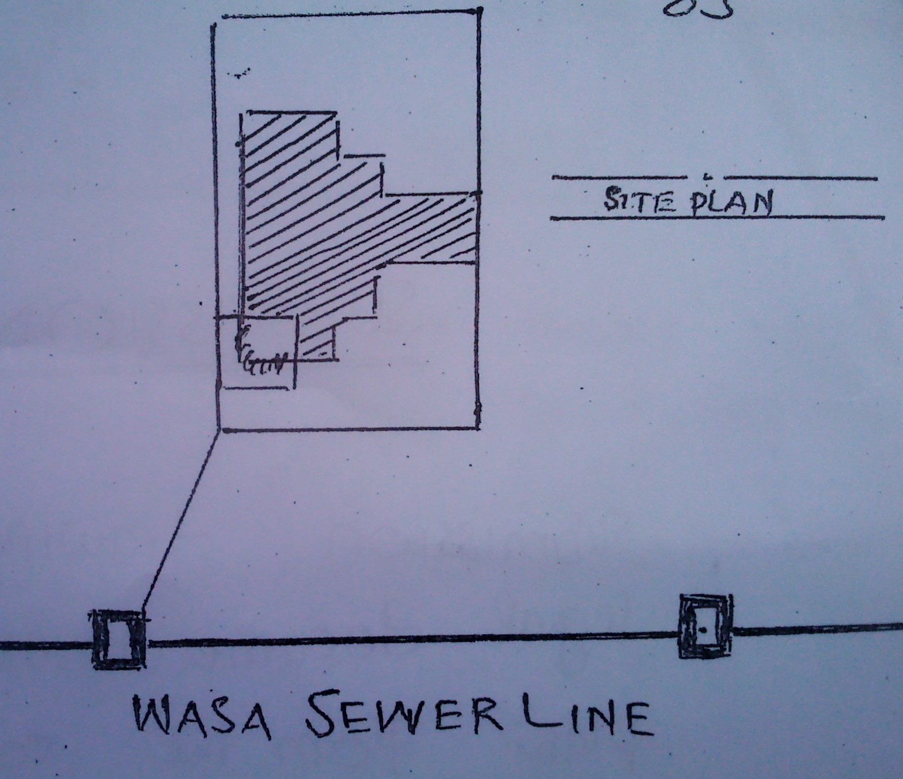
Site Plan
(Scale : 1/32 or 1/16) is required if size of plot > 10 marlas. Site plan shows the constructed portion by cross-hatching.
Various services are also shown in the site plan,(e.g. Sewerage line) connection for the plot is indicated.

Slide 25
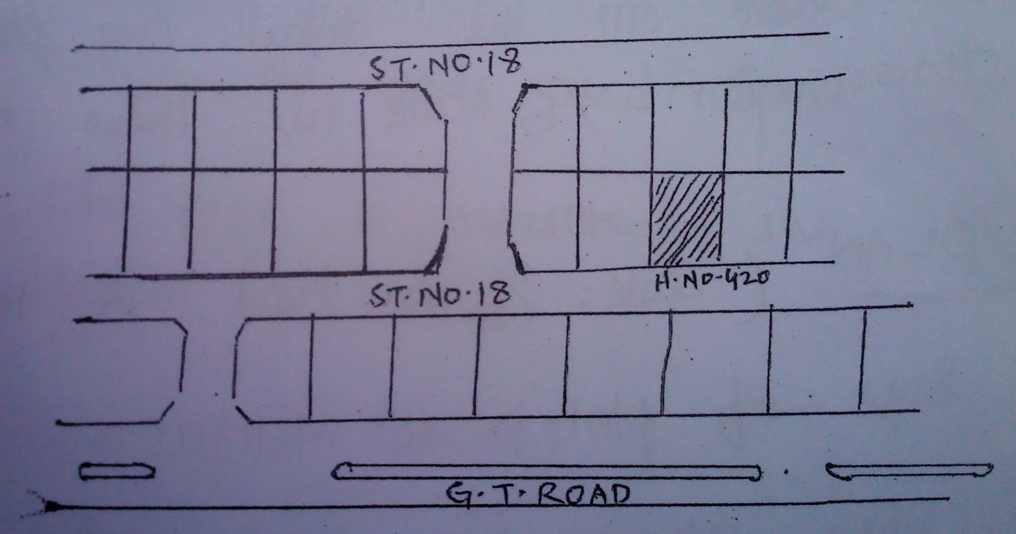
Location plan
(Scale: 1/64) is drawn to indicate the location plot.

Slide 26
Doors, windows & ventilators are marked by D₁, D₂----------W₁, W₂----------,& V₁, V₂-------- in the plans. Related details are given in the table called schedule of openings.
Total area of the plot, covered area, allowable covered area, G.F covered area, Ist floor covered area, etc are written in tabular form called schedule of areas.
Submission drawings should have the owner’s Name, Address, and Signature & should also be signed by Licensed Architecture. Sometime stability certificate is also required.
After the approval of these drawings, the construction can be started.

Slide 27
Working Drawings
Used to carry out construction at the site accordingly to the design. These include:
Architectural Working Drawings
These are made in which all the details are given which are necessary for site construction. Positions of various types of furniture are also indicated in the plans. More than one elevation is drawn.

Slide 28
2- Structural Working Drawings
Foundation plan
Reinforcement details
Plumbing works(water supply and its disposal inside the building)
Details of doors & windows
Bathroom and kitchen details
Electrification plan

Slide 29
3- Completion drawings (As built Drawings)
After construction of building, drawings are made according to the actually constructed features.
These drawings are then submitted to the authorities to get the completion certificate & only after their approval the owner can legally occupy the building.

