Slide 1
Post-earthquake Building Usability Assessment
Level 1: Rapid Evaluation
Geotechnical Issues
Jitendra Bothara

Slide 2
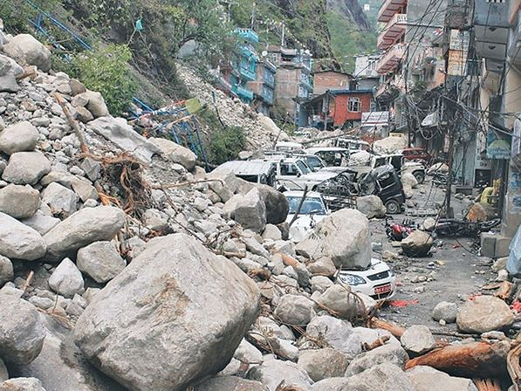
Rock fall
Unsafe/ Restricted use

Slide 3
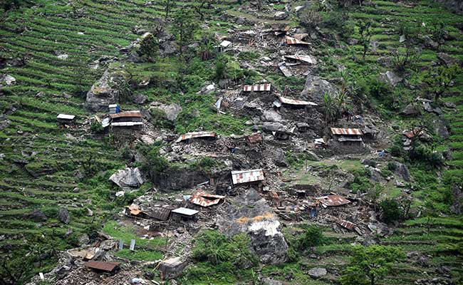
Rock fall
Assess uphill area
Building specific assessment
Unsafe

Slide 4
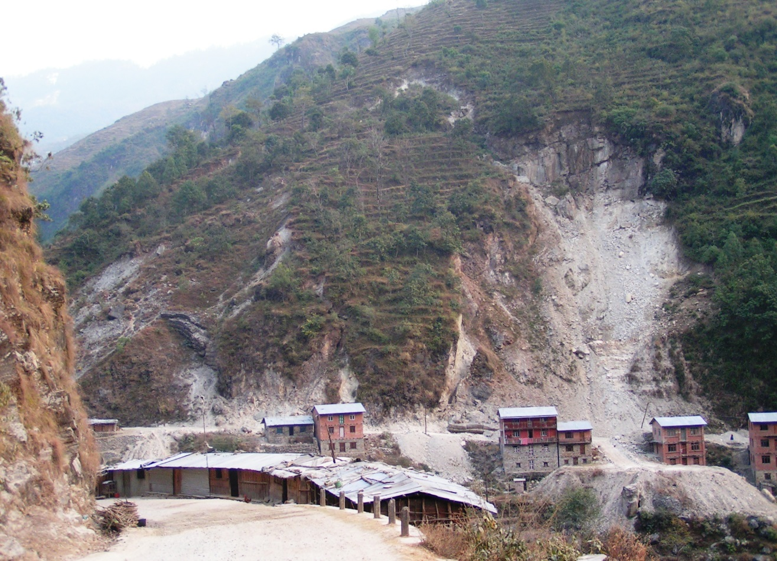
Landslide
Unsafe
Inspected/ Occupiable
Difficult to know until uphill area assessed

Slide 5
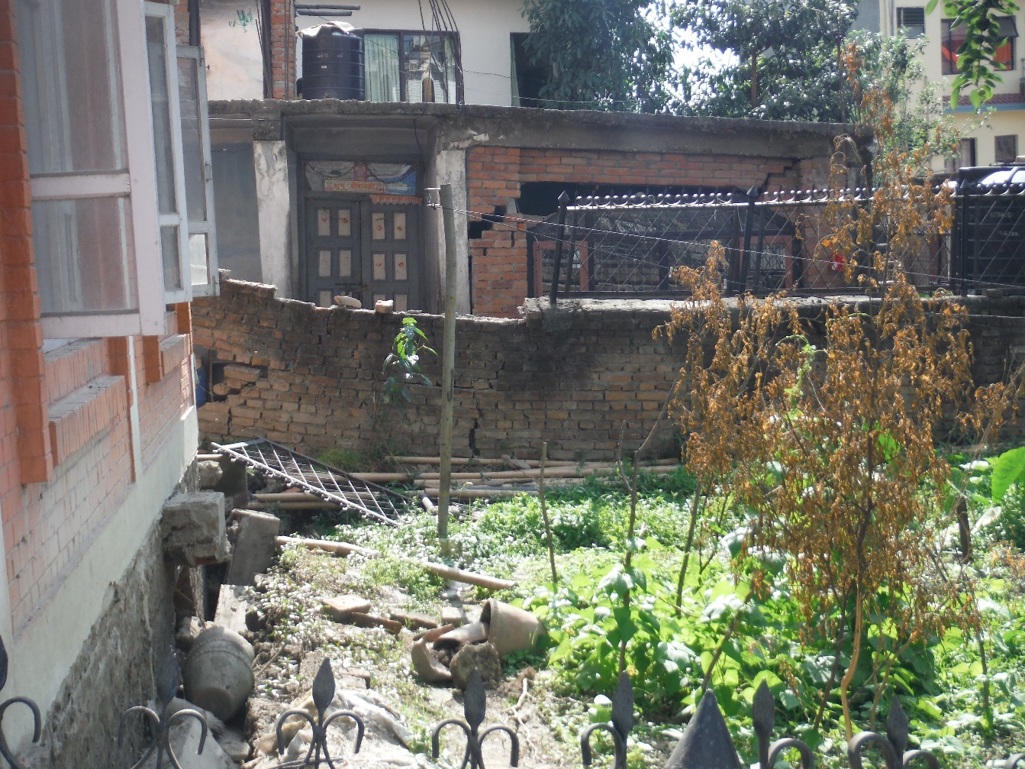
Ground settlement
Unequal settlement of ground
Unsafe/ Entry Restricted
Equal settlement
Inspected/ Occupiable

Slide 6
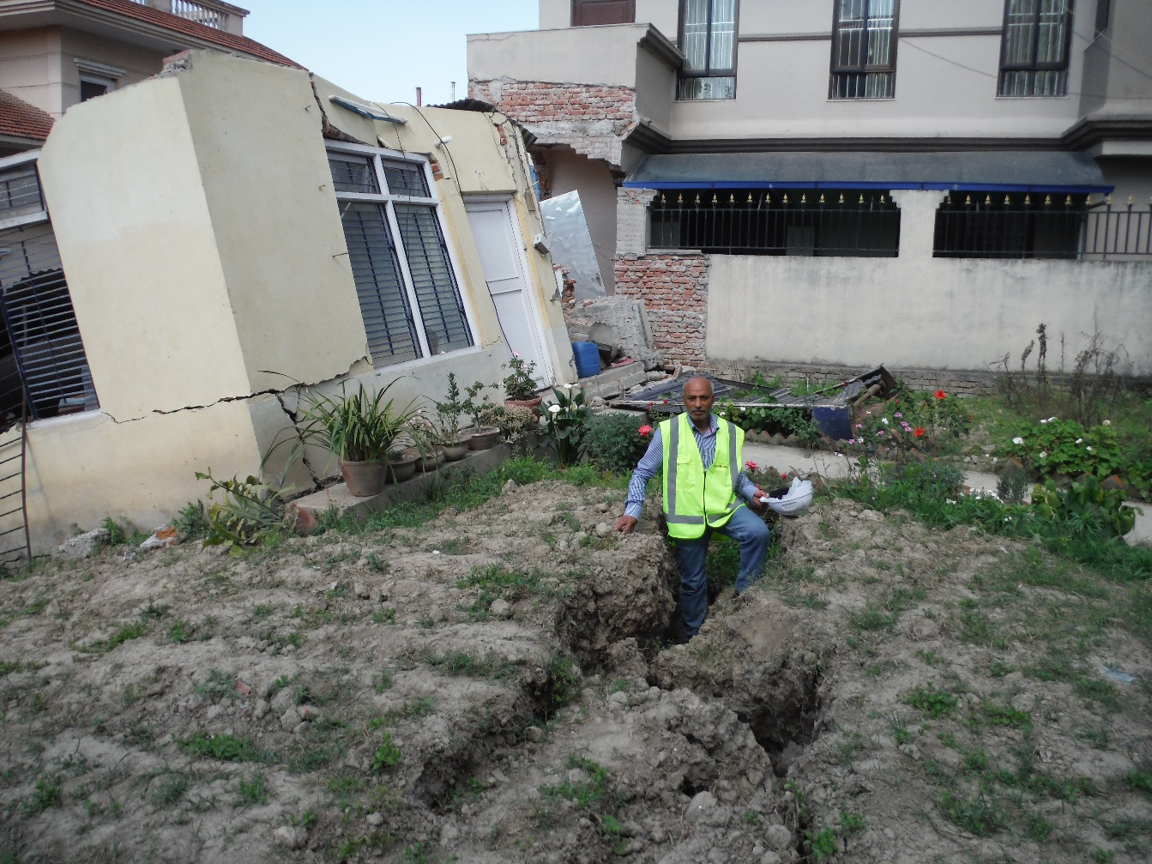
Ground settlement
Unsafe/ Restricted entry
Inspected safe to occupy

Slide 7
Acknowledgement
The information presented here have been pulled from various sources. This fact has been acknowledged.

Slide 8
ANY QUESTION?

